Slide 1
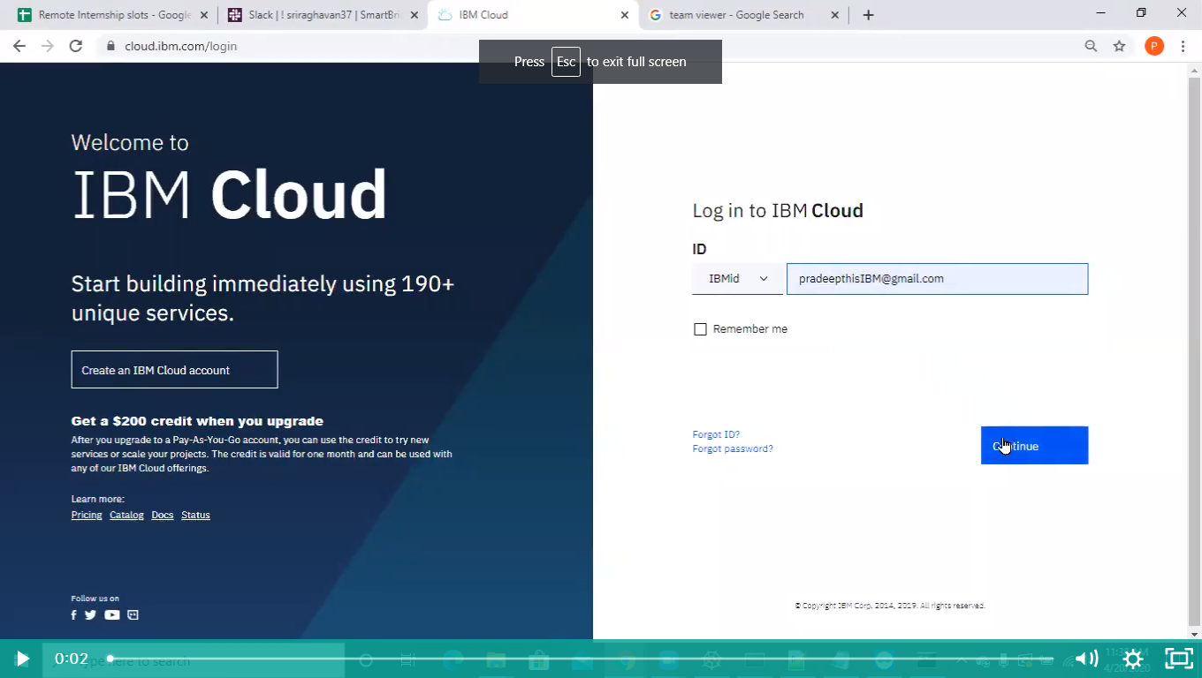

Slide 2
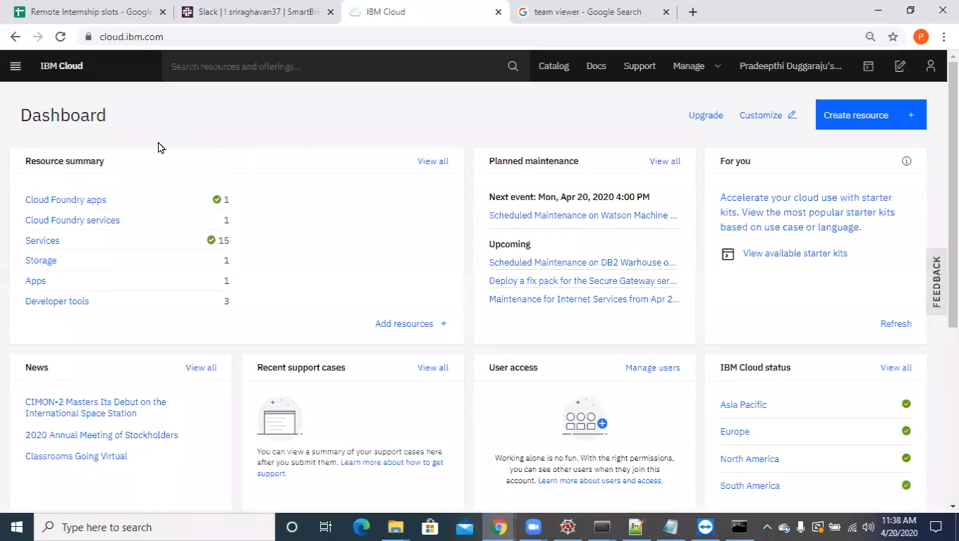

Slide 3
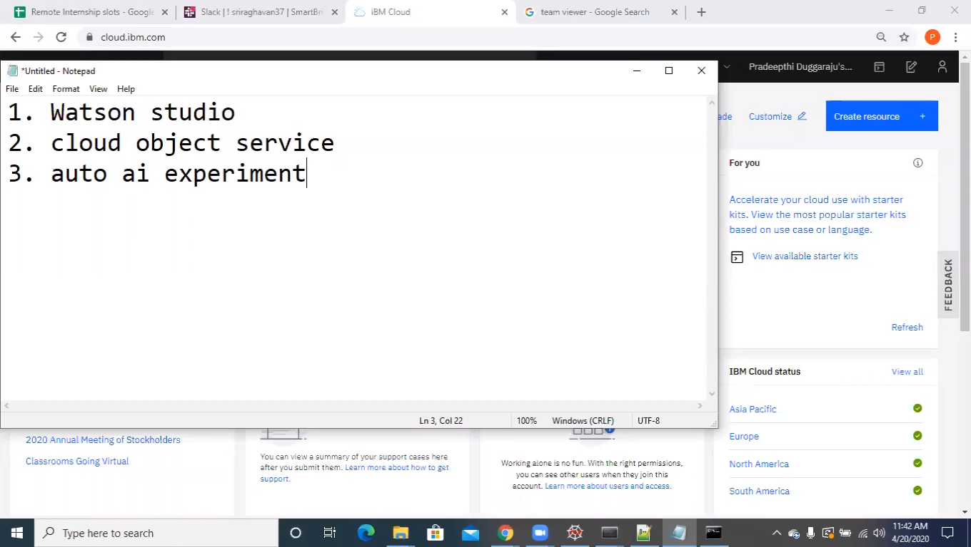

Slide 4
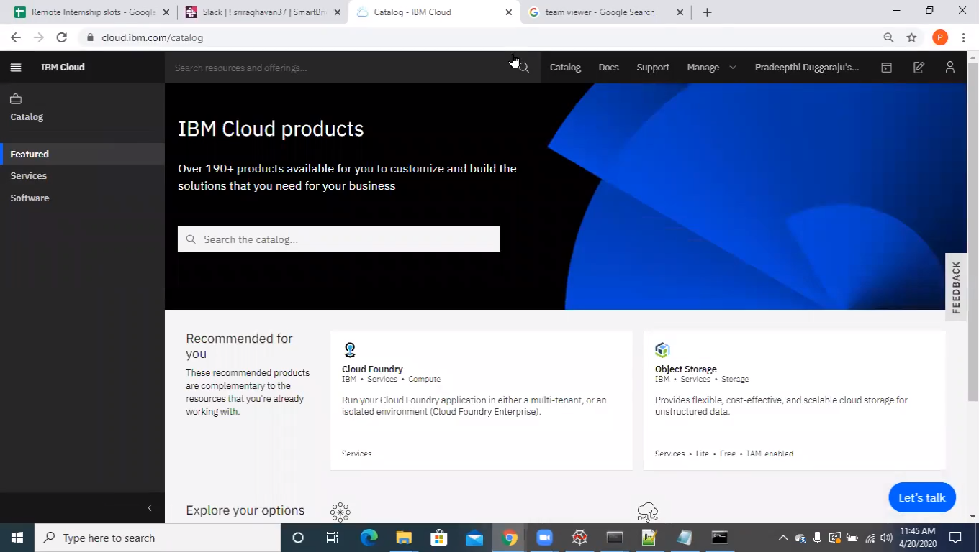

Slide 5
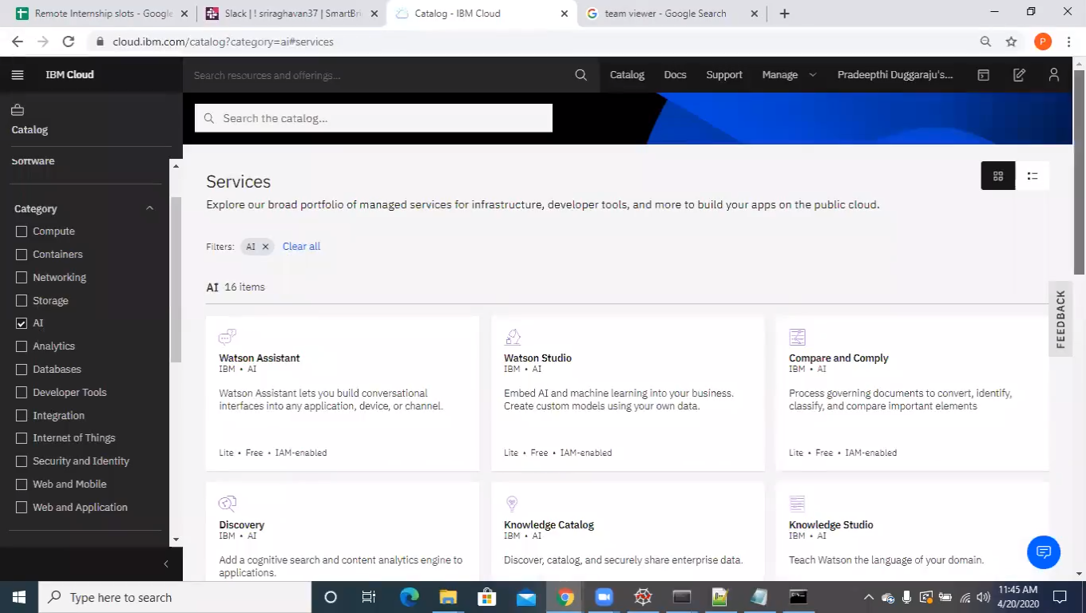

Slide 6
Watson AI Services
Watson Assistant - To build chat bots.
Watson Studio - Platform to integrate all the services
Compare and Comply - To compare any kind of document.
Discovery/ Knowledge Studio - To train question and answers.
Language Translator
ML Service/ NL Classifier/ NL Understand
Speech to Text/ Text to Speech
Tone Analyzer
Visual Rcognition - To recognize images

Slide 7
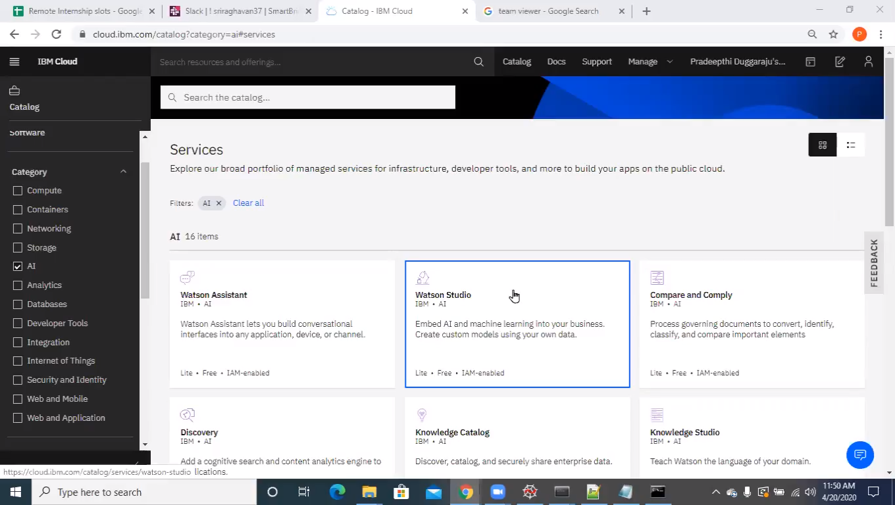

Slide 8
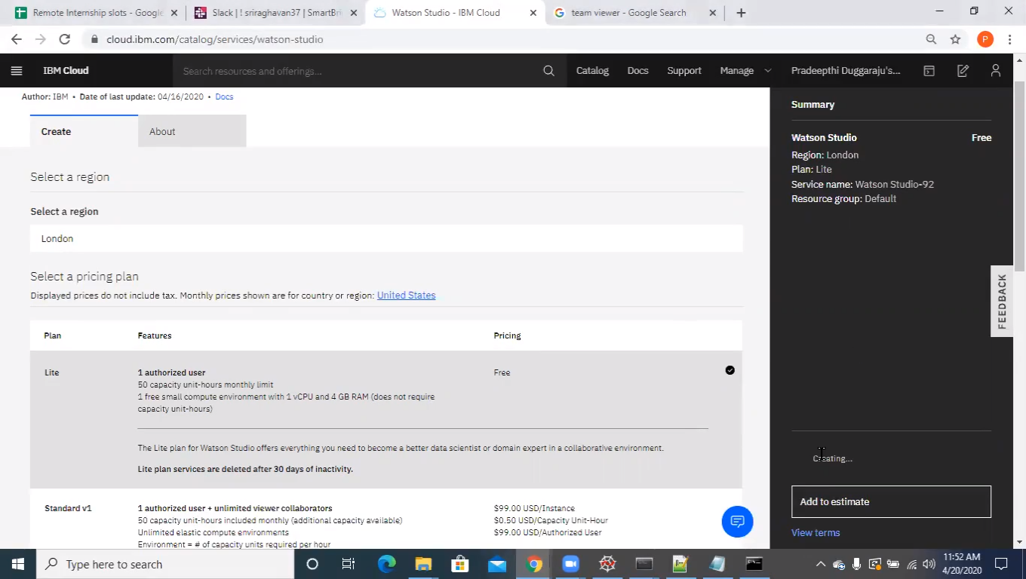
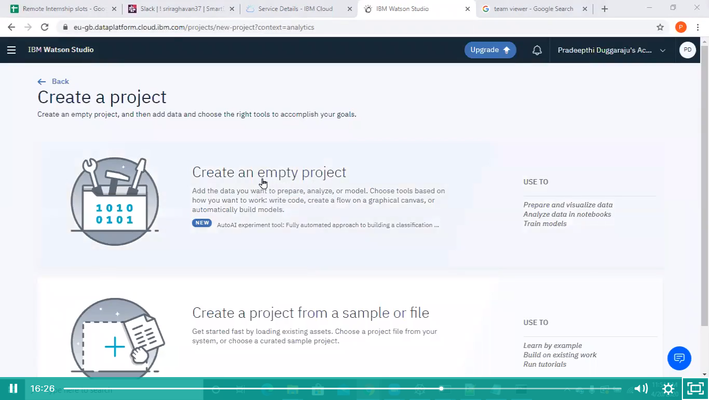
Watson Studio
Which will integrate all the other services in to one platform.

Slide 9
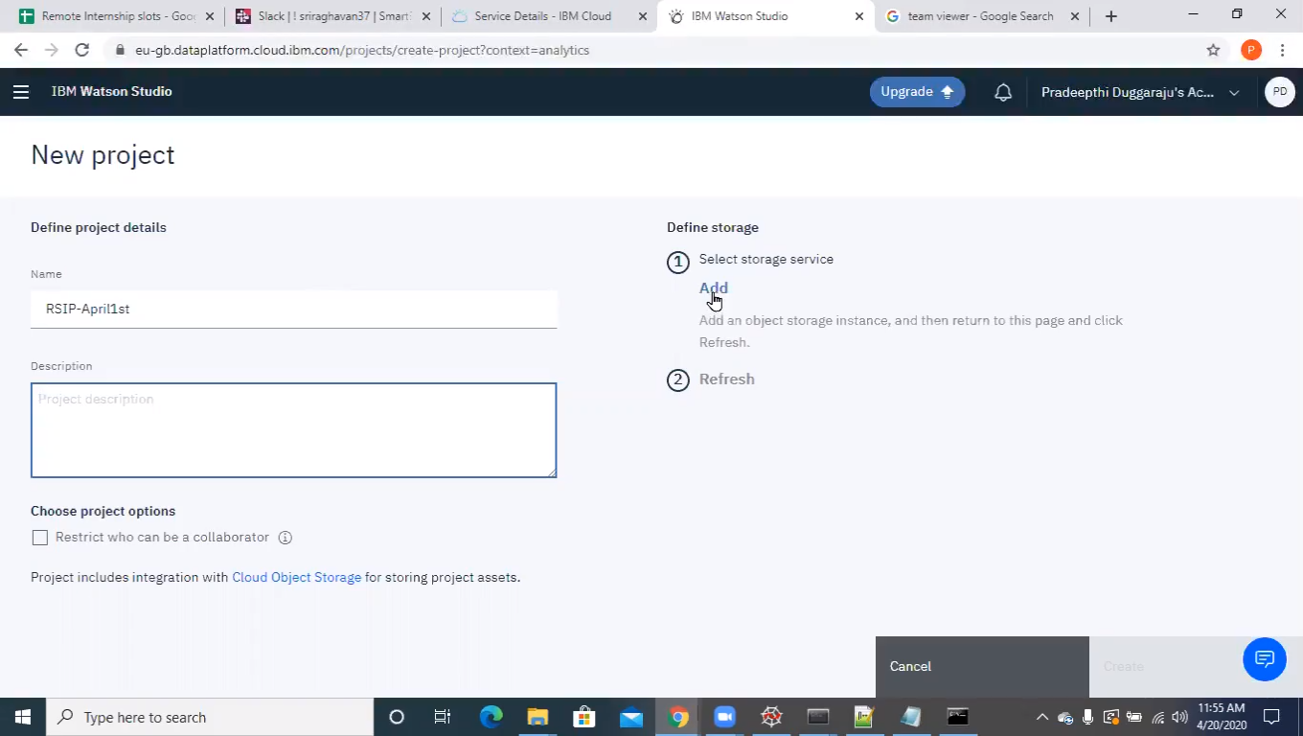

Slide 10
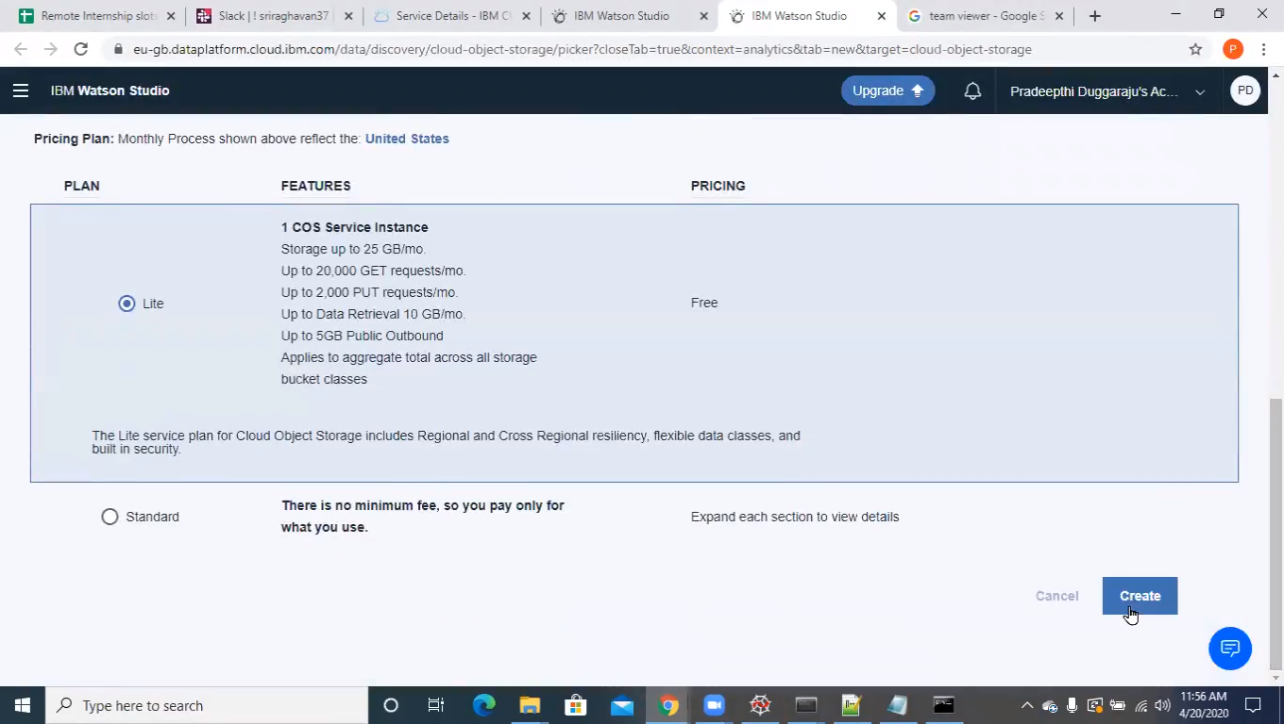
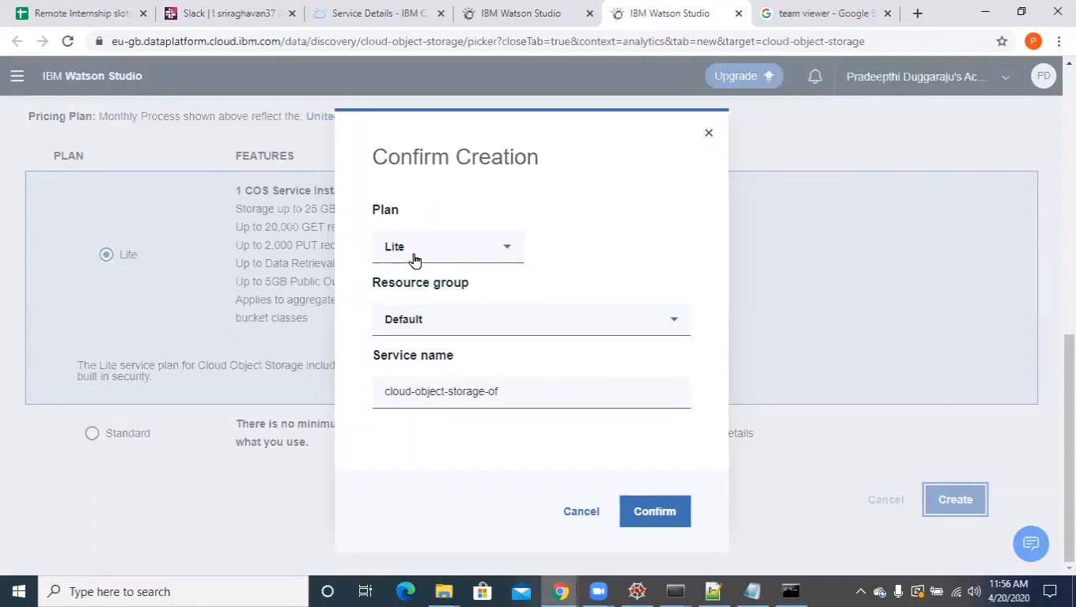

Slide 11
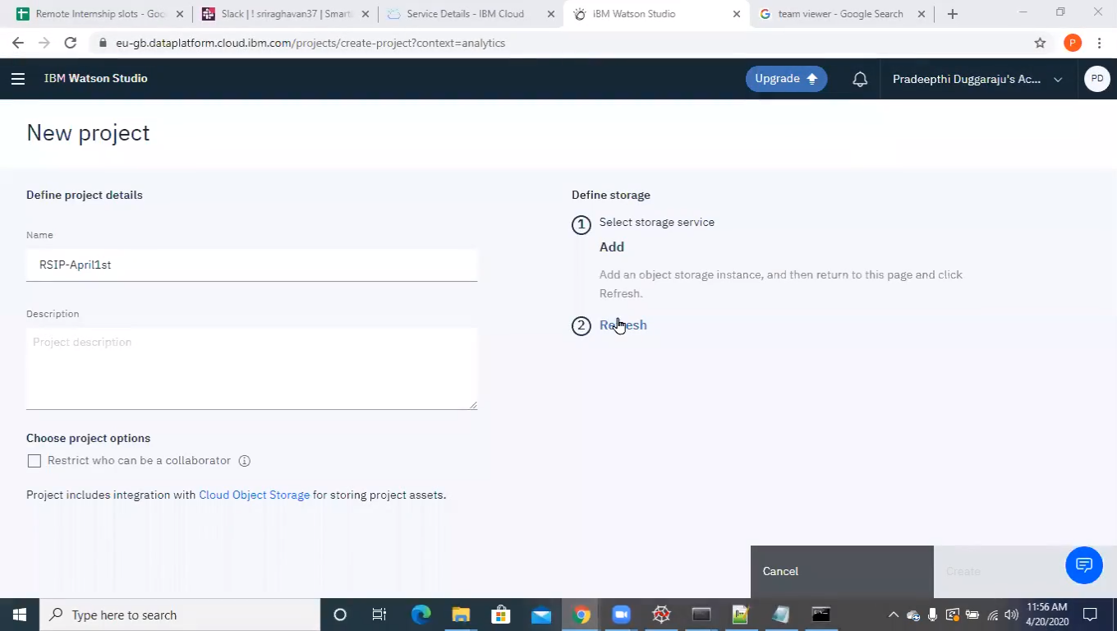

Slide 12
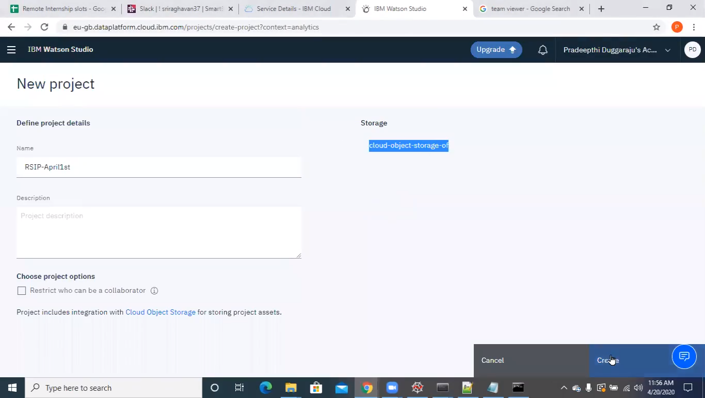

Slide 13
